Slide 1
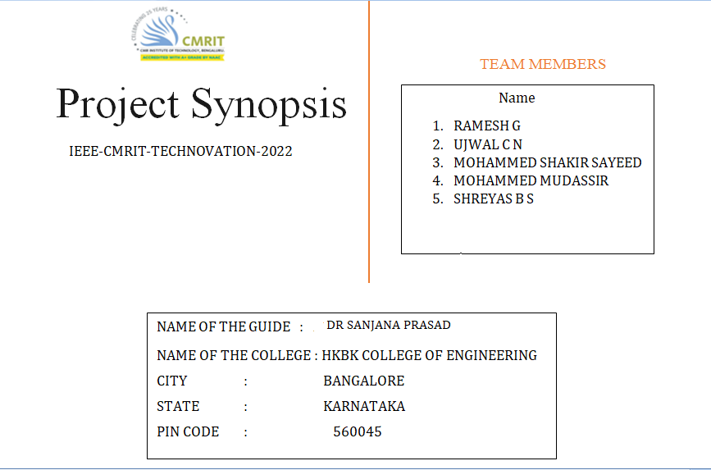

Slide 2
ABSTRACT
Self parking car can detect the space and Park automatically in that place.
The car detects the space present and calculates whether it can park their or not if the space is sufficient to park the car starts to park automatically without touching the other cars it gets the data from the sensors which are set around the car by taking the data from sensor and proper calculations the car parks itself in the given space.
The speciality of this auto Park system is that it can be parked and unparked using a mobile app which is built from the scratch using Android studio and firebase database as a back end server

Slide 3
INTRODUCTION
Automatic parking is an autonomous car maneuvering system that moves a vehicle from traffic lane into a parking spot to perform parallel, perpendicular or angle parking.
The automatic parking system aims to enhance the comfort and safety of driving in constrained environments where much attention and experience is required to steer the car.
The parking maneuver is achieved by means of co-ordinated control of the steering angle and speed which takes into the account. The actual situation in the environment to ensure collision free motion within the available space.

Slide 4
PROBLEM STATEMENT
While we are parking the car we waste a lot of time on it so we have to find a way to park automatically. This auto parking technique is already implemented in Tesla cars but in India it's not yet implemented.

Slide 5
SOLUTION STATEMENT
To solve this problem we have made self parking car which can detect the space present and park automatically in that place.
The car detects the space present and calculates whether it is fit to park their or not if the space is sufficient to park the car starts to park automatically without touching the other cars.
The speciality of this auto park system is that it can be parked and unparked using a mobile app which is built from the scratch using Android studio and firebase database as a back end server.

Slide 6
OBJECTIVE
Self parking car can detect the space present and park automatically in that place.
The car detects the space present and calculates whether it is fit to park their or not if the space is sufficient to park the car starts to park automatically without touching the other cars it gets the data from the sensors which are set around the car by taking the data from sensor and proper calculations the car parks itself in the given space.
The speciality of this auto park system is that it can be parked and unparked using a mobile app which is built from the scratch using Android studio and firebase database as a backend server.

Slide 7
METHODOLOGY
In this self parking prototype, we are going to control the car using IOT based app.
There are two options in the app that is park and reset.
Reset is used to clear the previous instruction.
When park option is selected, a notification will be sent to node MCU and node MCU updates the message to Arduino board.
Arduino board controls the components connected to it on the basis of the code written.
According to the code, when the park option is selected, the car starts moving, a sensor is placed on the left side which keeps on detecting the obstacle on the left side and moves on.
When the obstacle is not detected by the sensor ,the car moves a little bit front and the rotation of 90 degree is made and the car moves in reverse.
Sensor will be placed on back side to avoid the car to crash to the obstacle which is present backside.

Slide 8
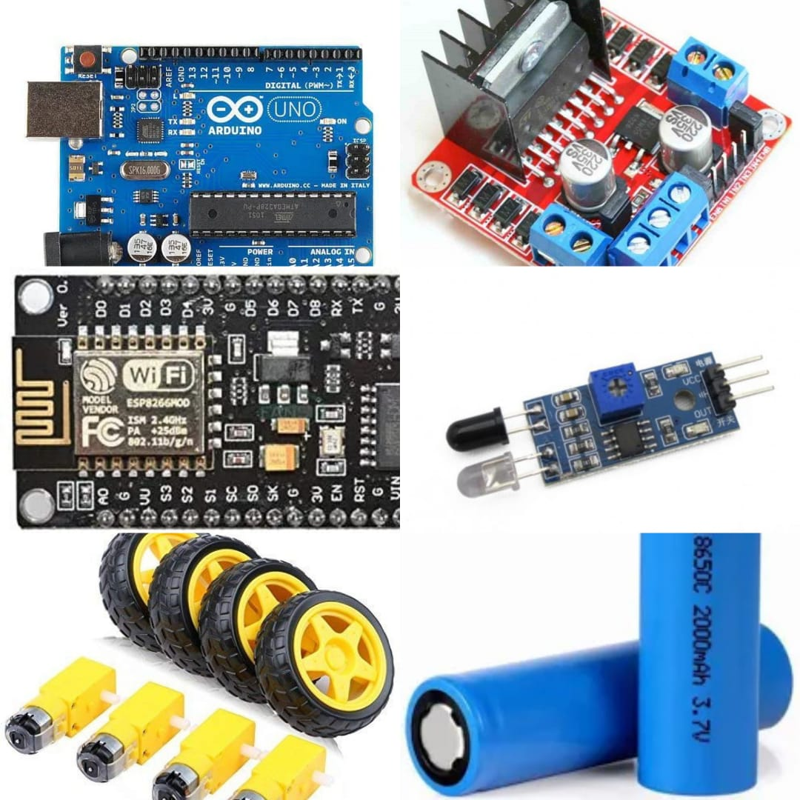
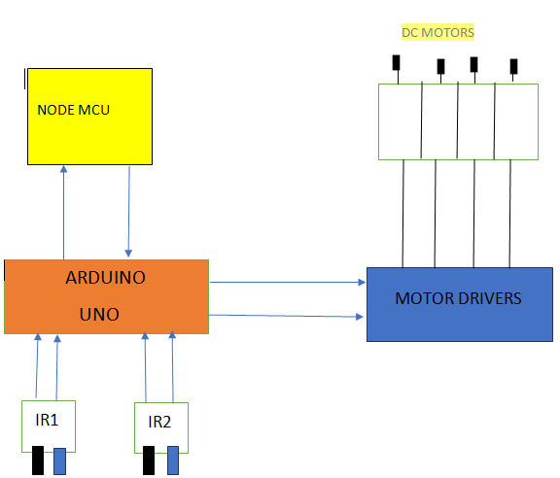
HARDWARE REQUIREMENTS

Slide 9
HARDWARE
The circuit diagram of the self working car is as shown in the above block diagram.
Node MCU is connected with the ARDUINO board whenever node MCU gets the park signal, it triggers the ARDUINO and the ARDUINO starts to park the car by taking the readings from the IR sensor 1 and 2 and providing output to the motor driver.

Slide 10
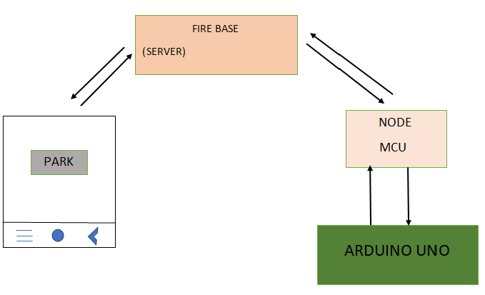
SOFTWARE REQUIREMENTS

Slide 11
SOFTWARE
The block diagram of the software components is shown above, the app is installed on required device whenever the park button is pressed the app, it sends a park signal to firebase database and it forwards the data to the node MCU and further it is passed on to the order of board.

Slide 12


